Slide 1
WRS Alignment Talk XI:
WRS Organizational Structure
Purpose:
  Understand how money serves as a proxy for value
  Understand how WRS is organized around provision of customer value
  Understand why the WRS organizational structure exists in its present form

Slide 2
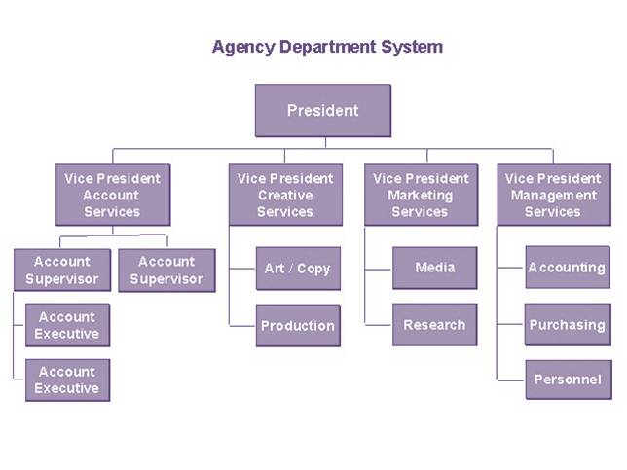
Can you send me a WRS Org Chart?
Question limits how you think
Hierarchical and Static
Silos of thought and work
Single Points of Failure
Titles and Roles Primary Keys
Ego and Power preservation reinforced.
Secretive
Activity (Doing Stuff)
Relational and Dynamic
Cooperation and SF Teams
Resilient and scalable
Customer Primary Key and Customer Value Defines DOD
Cooperation and Communication
Open
Achievement (Getting Stuff Done)

Slide 3
I think I understand what you are saying, but can you give me an example of a situation or behavior where this was a problem? Sure
Marketing: I was told only the VP of Marketing is allowed to communicate the ideas of the marketing team
Clinical: Only someone with a medical degree can understand clinical ideas
Finance: Why did we do it this way, that makes not sense to you does it? No. Then why did you do it? I was told to do it that way and I wouldn’t understand the details.
Sales: Sales are very complex, you wouldn’t understand
Dev: It will take us six months before I can show you something

Slide 4
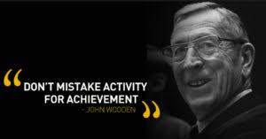
Coach John Wooden
Get the best players
Players have to be about the team and not themselves
Stick to the basics (less is more)
We’re too busy to open our doors, speak with you and cooperate

Slide 5
Organizational Behavior and Values will be Reinforced by our Organizational Structure
Form follows Function – Louis H Sullivan
Databases: Relational vs. Hierarchical
Servers: Balancing and Clustering vs. Single High Performance Machines
Internet built for resilience
Relational and Dynamic
Cooperation and SF Teams
Resilient and scalable
Customer Primary Key and Customer Value Defines DOD
Cooperation and Communication
Achievement and Persistence to DOD
Transparency, Honesty, Scalable, Open Architecture
World is Dynamic

Slide 6
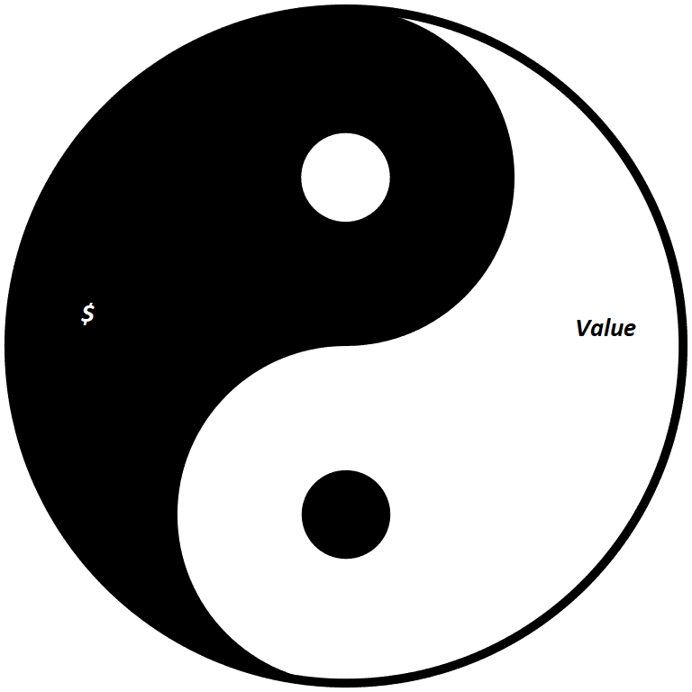
Yin Yang Duality
Money and Value
Wikipeda
In Ancient Chinese philosophy, yin and yang is a concept of dualism, describing how seemingly opposite or contrary forces may actually be complementary and interdependent in the natural world

Slide 7
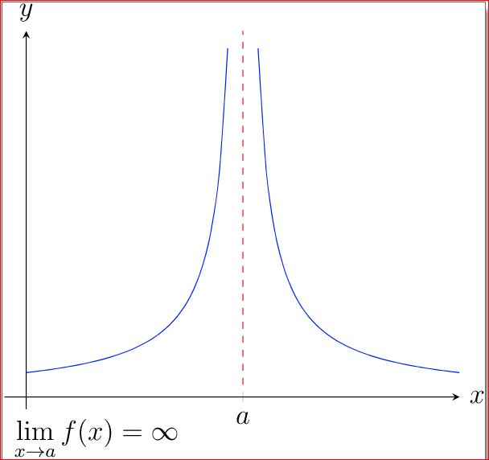

Asymptote and Sisyphus

Slide 8


Value is what you should derive when using software
What does the customer value?
Customer $ to WRS
WRS Provides Value to Customer
Notes:
Mismatch happens when they don’t achieve the expected value

Slide 9
Understanding Value
What we commonly value as individuals
Health
Good food
Comfortable shelter
Useful and beautiful objects and environments
Education, Knowledge and Insight
Freedom
Status
Happiness
Our Time
Clean Air
Fairness (cucumber and grape)
Safety

Slide 10
Understanding Money $
How do we use money?
Money is a proxy for value
Reservoir (place to store) our efforts (time)
  Is this worth spending $XX
  How much time and effort did it take you to earn $XX
  Is it “worth” it?
Normalize and standardize what we commonly value
  Milk and other consumable commodities
  IPhone
  Services like a haircut
Liquidity – easily exchange services and products
Future Security
  Pension
  Children’s Education
Sitting in a bank, investment fund, under our mattress
  Status
  Freedom

Slide 11
Gap between our understanding and the reality of what our customer’s truly value and their motivations
We mostly understand what money is and how it works
We have a feel for what we personally value and mostly act on our values and what we value
We have difficulty connecting with what motivates others:
  Cognitive mismatch in understanding what others value because we are mostly in our own head.
  Figuring it out requires questioning skills, listening skills, and a good deal of empathy. Important but inefficient to figure this out for each customer
We need to understand the value we can bring to our potential clients and have them align with the value they truly are seeking
We need tools and structure to help with this

Slide 12
Example: Scheduler Software
What do we sell? Integrated scheduling software
How does this help our client? It helps our clients manage their time by enabling the management of patient appointments.
Why is this important to our client(s)? Left unmanaged, our clients time could be wasted by having unused time/gaps in their schedule, or scheduled time that is not used effectively/efficiently.
So it is important to our clients to use their time efficiently and effectively?
Yes, they both personally value their time (nobody likes to waste their time) and it has an economic impact on their practice.

Slide 13
User Story and Definition of Done based on Client Value
User story: As a phyician I need a well designed scheduling systme to opimitze the use of my time because I value my time.
Development: DOD is creation of scheduling software that enables optimal time management of physician
Services: DOD measures scheduling performance around efficient use of time.
Marketing articulating the value of the scheduling software
Sales, selling what the scheduling software can do for the management of the provider’s time

Slide 14
Well Designed System with System Properties
Not just the Software
People
Processes
Value or Goal
Tools/Software
Notes:
Mismatch happens when they don’t achieve the expected value

Slide 15
Value Toolkit/Checklist
5 Whys
System properties: reliable, repeatable, sustainable
People, Processes, Tools
User Story
Problem/Solution Model
Perception of value is dependent on the individual
Our Value=What they value

Slide 16
Examples of Our Value to Clients
Continually improve and optimize their practice:
  Providing them with a system to help them run their practice
  Continual improvement and optimization
  Specific measurable goals and KPI
RCM
  Value statement: all services rendered completely and correctly billed. All claims completely and correctly paid.
  System to remove root causes of why this doesn’t happen
Clinical
  Optimize provider time by removing unnecessary data collection, entry and transfer.
  System for clinical care delivery
Front Desk:
  Bottleneck problem impacts all other processes
  Amenable to systematization, automation and BPO
Marketing and Reputation Management: Unique system to manage:
  Website: how the practice perceives its unique value
  Reviews: how the patients perceive the care we provide

Slide 17
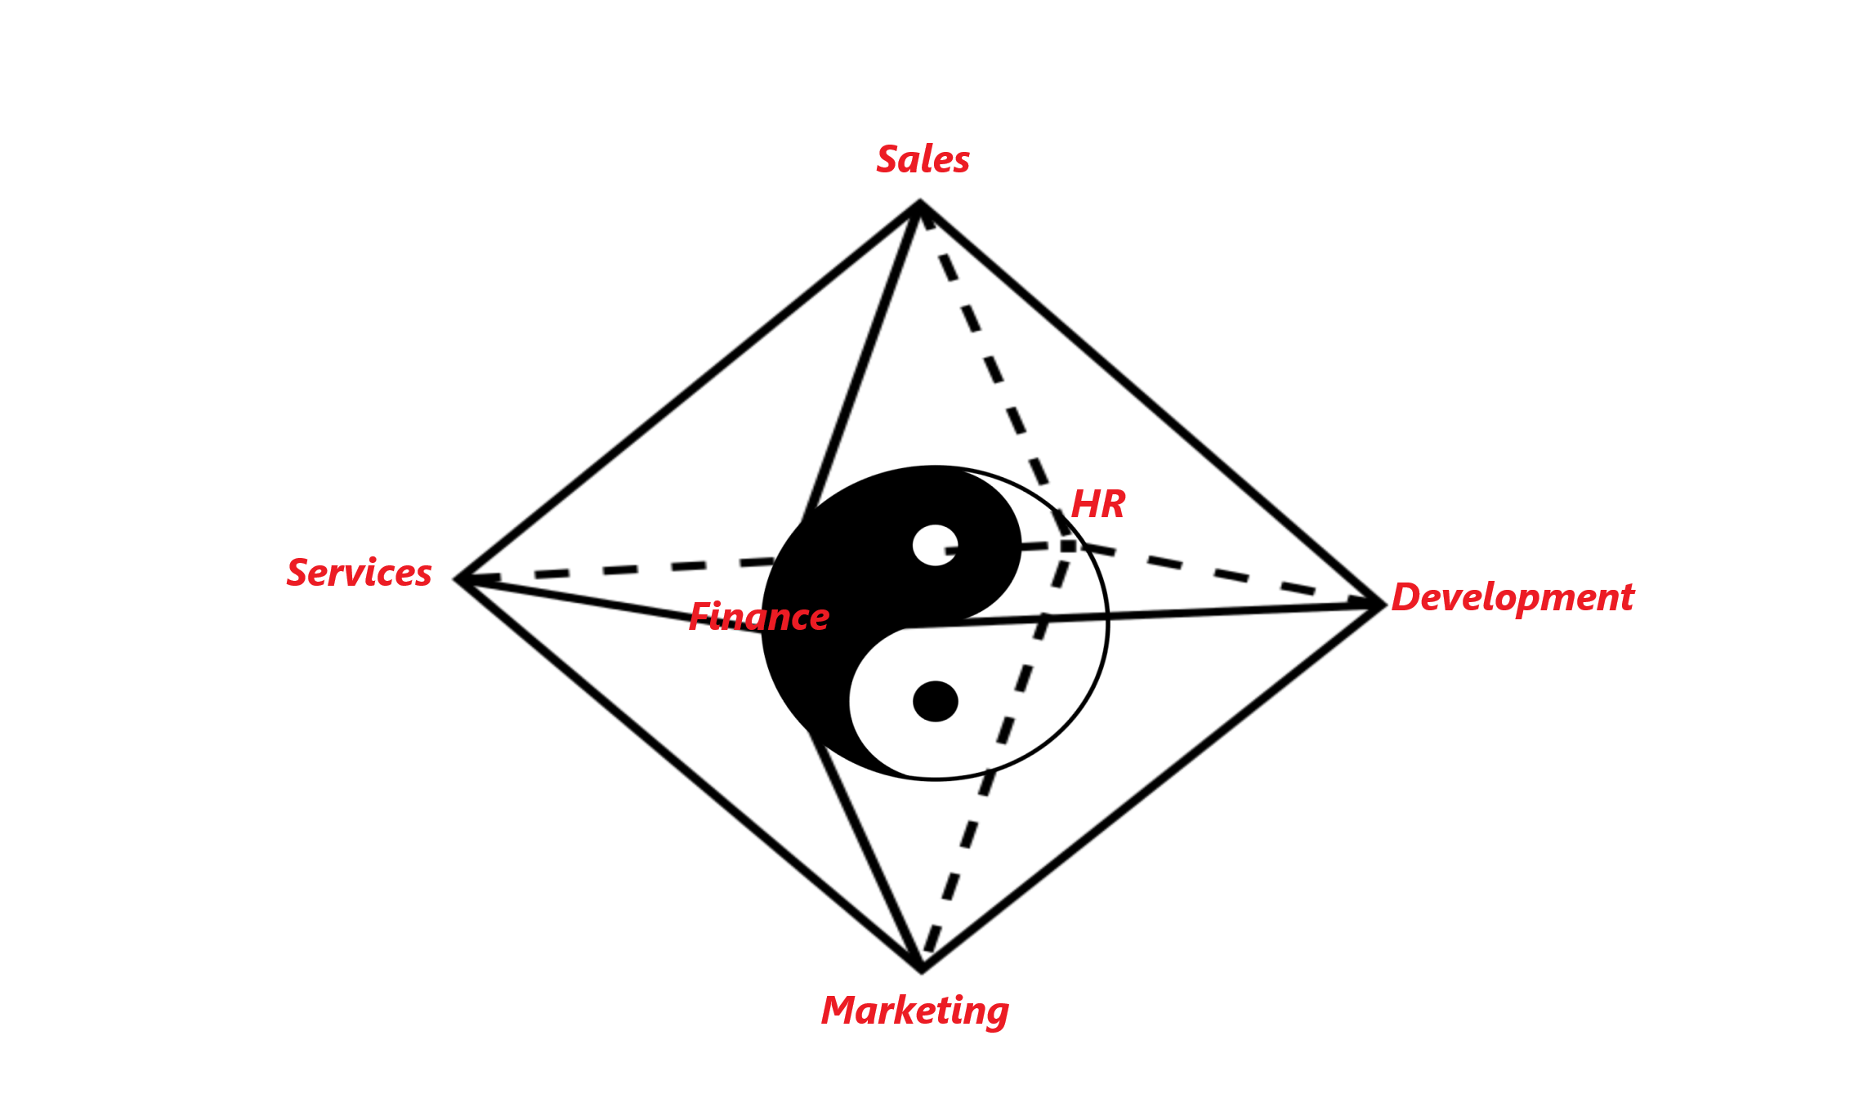
WRS Structure and How Client Value Creation is Functionally and Practically Used When We Work Together

Slide 18
Stop thinking of us this way

Slide 19
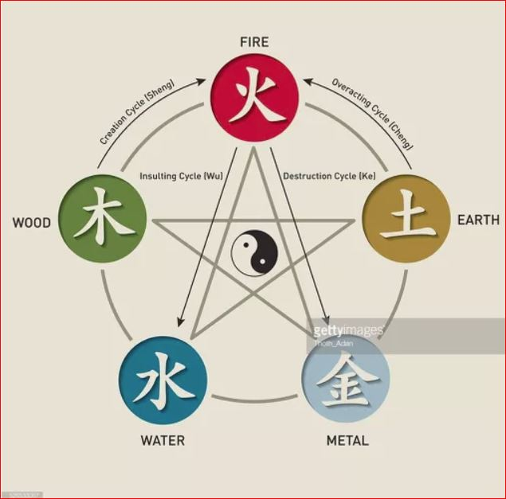
Thinking Relational, Thinking Balance

Slide 20
WRS Structure: Who assumes these roles?
Relational not hierarchical
Centered around dynamic relationship with client (primary key) and relationship to one-another

Slide 21
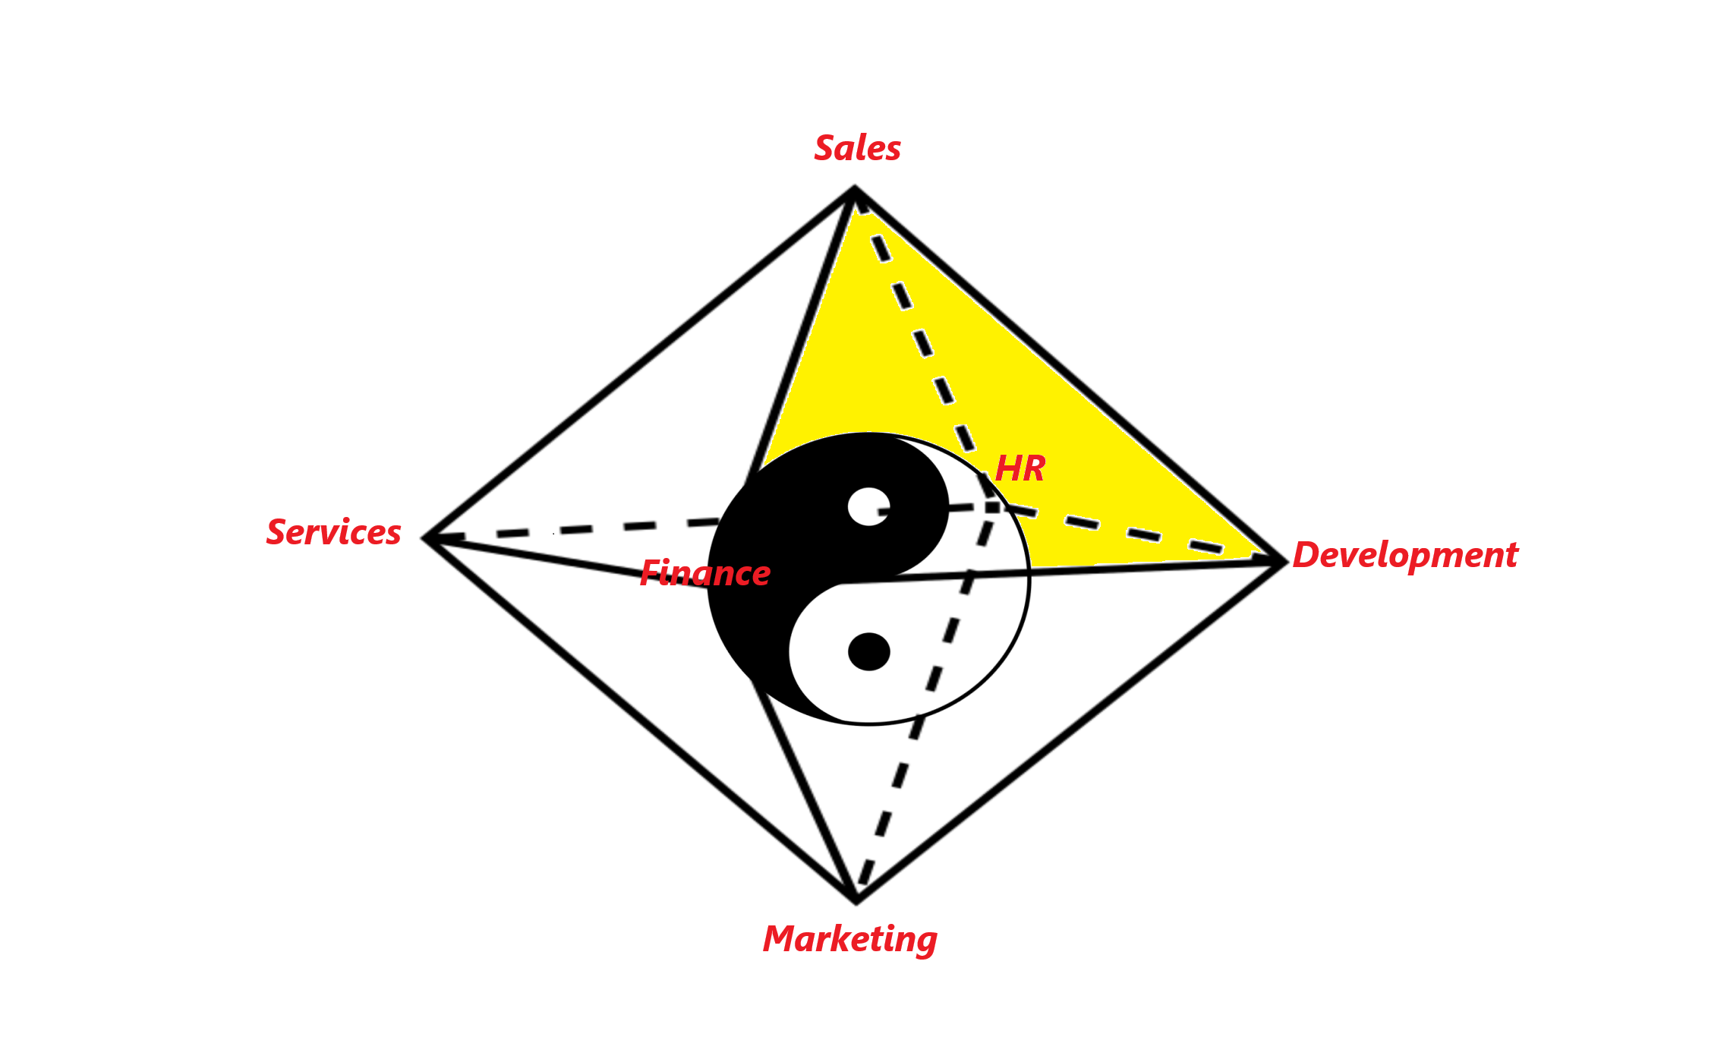
Example of Self Forming Cross Functional Team

Slide 22
Development and Services Duality
User Story and Value at the Center
Development
(not just functionality)
Services
(not a commodity)

Slide 23
Marketing and Sales Duality
Marketing
(Articulates our value)
Sales
(Agrees to deliver our value in return for monetary payment)

Slide 24
Finance and HR Duality
Relationship between Individual Performance and Company Performance with Customer Value at Center
HR
(Individual Performance and Feedback)
Finance
(Company Performance and KPI Measurements)

Slide 25
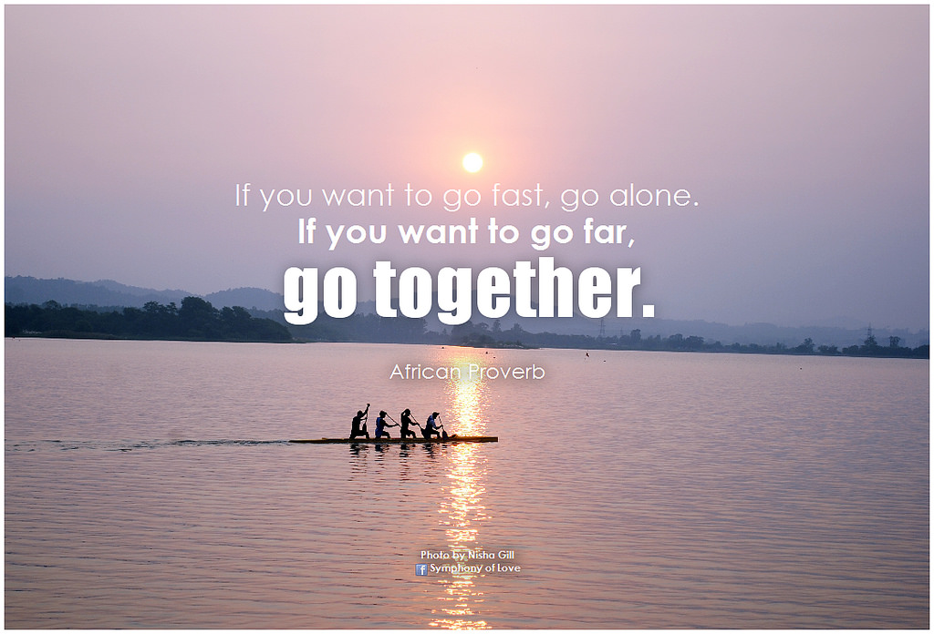
Yes, you can….

